Slide 1


CELL FOUNDRY
Meeting Title: Biweekly meet - 3
PAVIN SUMATHI PALANICHAMY · PRETHEBHA MUTHUKUMARAN · PRIYAM JHA
MENTOR: PROF. DR. MAGDA GREGOROVÁ
DATE: 05.11.2026

Slide 2
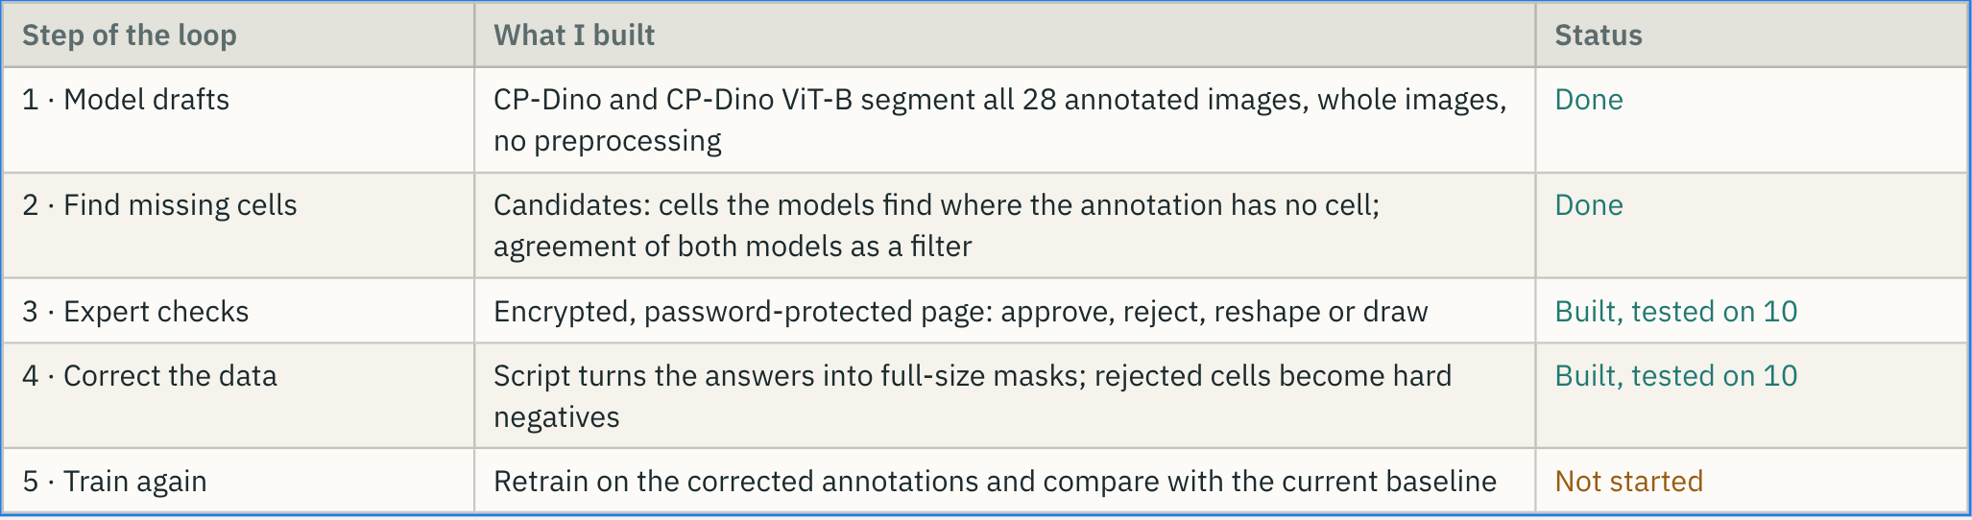
Better data · Active learning
Methodology: the models propose, the expert only verifies, and confirmed cells and confirmed non-cells (hard negatives) go into the next round.
CELL FOUNDRY
Meeting Title: BiWeekly Meet - 3

Slide 3
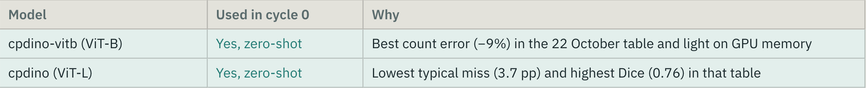
Cycle 0: 1,795 candidates, 100 sent to review
28 annotated images scanned with both models
1,795 candidate cells in unannotated territory
678 found by both models
100 in the review package, from 21 images
A candidate is a predicted cell with less than 10% overlap with any annotation and an area of at least 150 pixels
Both models have to agree (IoU of at least 0.30): used as a filter
At most 6 per image, for diversity. The 6 test images are never exported; their 322 candidates were only counted
Cycle 0 used the two best zero-shot models
CELL FOUNDRY
Meeting Title: BiWeekly Meet - 3

Slide 4
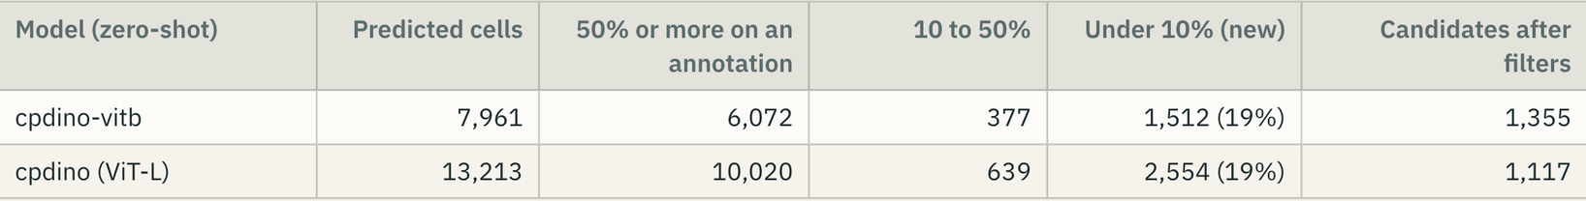
WHAT THE MODELS FIND
THESE ARE PROPOSALS, NOT MISSED FAT CELLS. SOME ARE STEM CELLS, DEBRIS OR FRAGMENTS, AND THE MODELS ALSO SPLIT WHAT IMES DREW AS ONE LARGE CELL. ONLY AN EXPERT CAN DECIDE.
CPDINO PREDICTS 66% MORE CELLS THAN CPDINO-VITB ON THE SAME IMAGES, WHICH MATCHES ITS COUNT OVER-ESTIMATION (+58% AGAINST −9%).
CELL FOUNDRY
Meeting Title: BiWeekly Meet - 3

Slide 5
EXPERT REVIEW TOOL
A CONFIDENTIAL REVIEW PAGE FOR THE IMES EXPERT
WHAT THE EXPERT CAN DO
  Approve or reject each candidate cell
  Drag the yellow outline to reshape it; a cell cut by the image border can be stretched to its true size
  Draw a new outline for a fat cell nobody marked
  Answers stay in the browser until downloaded as a CSV of decisions and a JSON file of outlines
HOW THE DATA STAYS PROTECTED
  One encrypted HTML file with password, opened offline in a browser
  The page cannot contact any server, so nothing is uploaded
  Shared only through the THWS Cloud, with the password sent separately
  No model confidence on the image, so the expert is not biased
CELL FOUNDRY
Meeting Title: BiWeekly Meet - 3

Slide 6
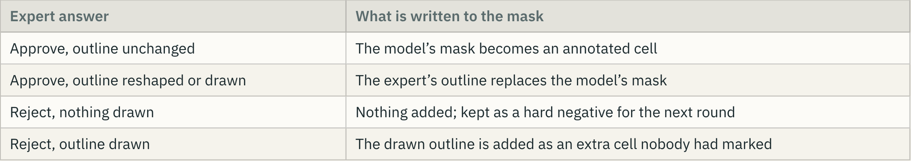
EXPERT ANSWERS BECOME TRAINING MASKS AND HARD NEGATIVES
Impact precision = confirmed ÷ proposed. It tells us how much work IMES saves compared with annotating from scratch.
Output: one full-size label image per source image, in the pixel coordinates of the original, plus a summary file listing where every cell came from.
CELL FOUNDRY
Meeting Title: BiWeekly Meet - 3

Slide 7
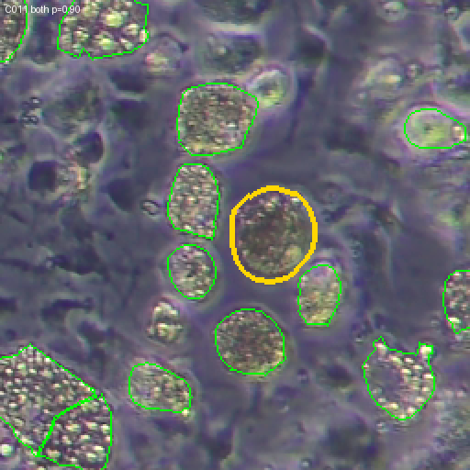
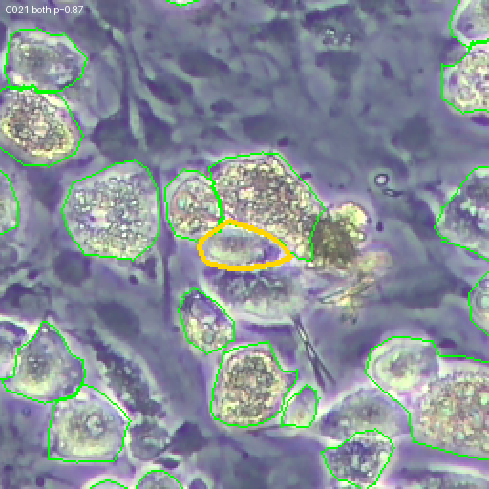
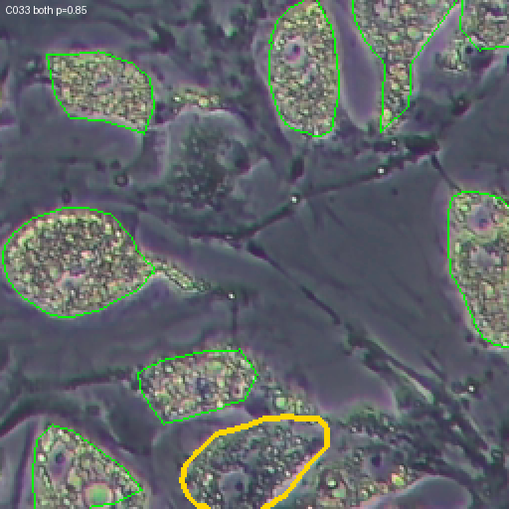
OUTPUT PREDICTIONS OF ACTIVE LEARNING
CELL FOUNDRY
Meeting Title: BiWeekly Meet - 3

Slide 8
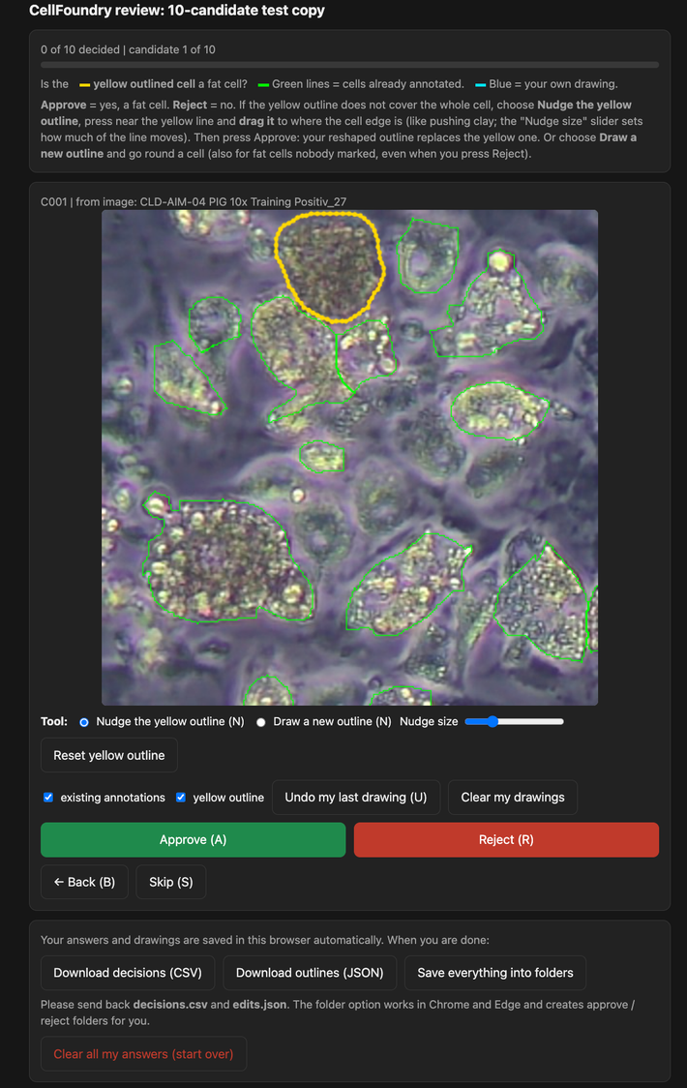
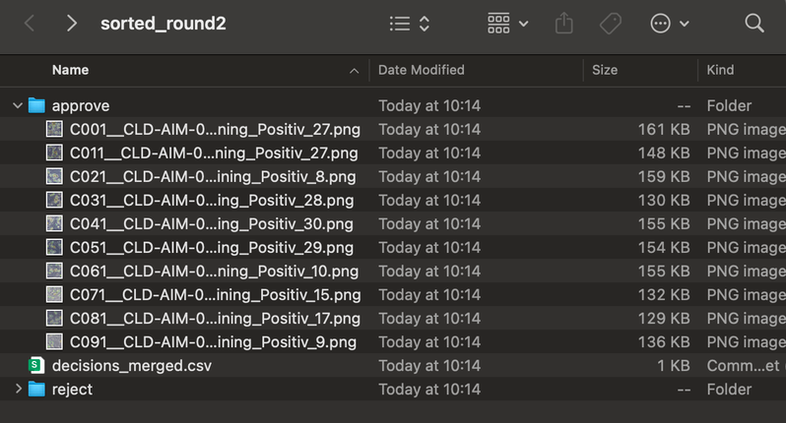
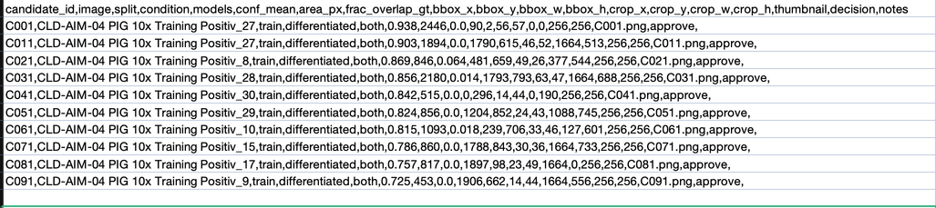
DEMO
CELL FOUNDRY
Meeting Title: BiWeekly Meet - 3

Slide 9

Why no single number can be trusted?
  Incomplete reference - Mask’s fat % is a lower bound
    0 means 'not annotated', not 'not fat”
    When a model finds more fat than the mask, it may be real
  Average errors rule out: +4 and -4 (an average can look perfect when the errors cancel)
    The updated current scorer uses absolute errors.
    zero-shot cpdino-vitb
      The plain average is −0.5 pp
      The miss, ignoring the signs, is 5.8 pp.
  Cellpose-SAM (cpsam) weights are CC-BY-NC
    BY - should give credits
    NC - non commercial
    DINOv3 appears to allow commercial use, with conditions: ship the licence text, credit it, and avoid military uses.
CELL FOUNDRY
Meeting Title: Biweekly meet - 3
Notes:
After the last meeting we wrote to Nicole and Jan with our open questions.
The most important question: which number do the users actually need? Only the proportion of fat in the image, or also the number, size and shape of each cell? This decides our method: for the fat proportion alone we could measure the fat area directly; for count, size or shape we must separate every single cell.
We also asked for their app and the exact DINOCell version, which images were used for training and testing (so our comparison is fair), the complete code package, what the file names mean, the microscope type, and whether more annotated images are possible.

Slide 10
How to read a difference from the mask
Model below the mask 17% vs 20%
  the mask leaves fat out, it does not add fat.
Model above the mask 23% vs 20%
  skipped fat, background, or area outside the outlines.
  Inspect before calling it an error.
Multi-piece cells: one ID, separate blobs
Sometimes one cell number appears in two places that do not touch.
Example: 1089 px blob plus an 851 px blob about 100 px apart.
But only it constitutes for 0.1% of the area (only matters for cell count)
CELL FOUNDRY
Meeting Title: Biweekly meet - 3
Notes:
After the last meeting we wrote to Nicole and Jan with our open questions.
The most important question: which number do the users actually need? Only the proportion of fat in the image, or also the number, size and shape of each cell? This decides our method: for the fat proportion alone we could measure the fat area directly; for count, size or shape we must separate every single cell.
We also asked for their app and the exact DINOCell version, which images were used for training and testing (so our comparison is fair), the complete code package, what the file names mean, the microscope type, and whether more annotated images are possible.

Slide 11
How training crops are cut: IMES vs our models
  IMES: Every step: random training image → random annotated pixel → 512 px crop with that pixel 128–384 px inside
  Our cellpose Models:
    Crop position is uniformly random, not centred on cells
    so maximum coverage of each image is reached over 100 epochs
IMES always crops around cells, so training rarely shows empty background.
Our models crop at random.
Possible reason cpsam stays quiet on the control image.
CELL FOUNDRY
Meeting Title: Biweekly meet - 3
Notes:
After the last meeting we wrote to Nicole and Jan with our open questions.
The most important question: which number do the users actually need? Only the proportion of fat in the image, or also the number, size and shape of each cell? This decides our method: for the fat proportion alone we could measure the fat area directly; for count, size or shape we must separate every single cell.
We also asked for their app and the exact DINOCell version, which images were used for training and testing (so our comparison is fair), the complete code package, what the file names mean, the microscope type, and whether more annotated images are possible.

Slide 12
Models and licenses
Clean to deliver
  nnU-Net Apache-2.0 (can use commercially)
  micro-SAM MIT, CC-BY-4.0 (same)
Can research, non-commercial
cpsam CC-BY-NC
cpdino, cpdino-vitb DINOv3 licence
CELL FOUNDRY
Meeting Title: Biweekly meet - 3
Notes:
Nicole answered on 15 October.
The key point: for the users, the most important number is the area covered by fat cells. The number of cells is also useful, but secondary. Today they get the area by segmenting every single cell. She is open to a different method if it works better.
The app cannot be shared at the moment, because it is part of a larger platform in an EU project. Instead, her Colab notebook contains the complete pipeline: preprocessing, metrics and loading the DINOCell weights.
Their baseline is DINOCell (not the DINO model inside Cellpose), fine-tuned by IMES. They are not satisfied with the results, and CellposeDINO would be interesting for them, which fits our zero-shot results.
They trained on all images in the training folder and have no separate test images. They judged new images by eye. All images are brightfield. More annotations are not promised, and Nicole does not want to annotate herself, because the biologists annotated the existing ones.
Consequence for us: fat-cell area becomes our primary metric, and we need our own held-out test images for a fair comparison.

Slide 13
cpsam zeroshot vs finetuned
Fine-tuning fixed cpsam.
CLAHE didn't help it, so we keep raw. images
Dinocell - performs worse than cpsam (overcounts cells on control)
nnU-Net: 100 epochs would take about 17 h for 3 repeats, so 10 epochs (about 1 h 45).
Results next meeting.
CELL FOUNDRY
Meeting Title: Biweekly meet - 3
Notes:
Nicole answered on 15 October.
The key point: for the users, the most important number is the area covered by fat cells. The number of cells is also useful, but secondary. Today they get the area by segmenting every single cell. She is open to a different method if it works better.
The app cannot be shared at the moment, because it is part of a larger platform in an EU project. Instead, her Colab notebook contains the complete pipeline: preprocessing, metrics and loading the DINOCell weights.
Their baseline is DINOCell (not the DINO model inside Cellpose), fine-tuned by IMES. They are not satisfied with the results, and CellposeDINO would be interesting for them, which fits our zero-shot results.
They trained on all images in the training folder and have no separate test images. They judged new images by eye. All images are brightfield. More annotations are not promised, and Nicole does not want to annotate herself, because the biologists annotated the existing ones.
Consequence for us: fat-cell area becomes our primary metric, and we need our own held-out test images for a fair comparison.

Slide 14

THIS WEEK: CPDINO-VITB AND A SHARED PIPELINE FOR THE TEAM
What was done
Hidden Cellpose behaviours we now guard against
  cpdino-vitb fine-tuned: test fat-% miss 5.80 → 2.79 pp (3 seeds, test used once)
  Built the shared split, scripts and protocol; the team ran ViT-L, cpsam and DINOCell with them
  First fair comparison of all models: fine-tuning matters more than the choice of model
  IMES's CLAHE reproduced exactly; it does not help cpdino-vitb/vitl and cpsam → raw input
  An unknown model name silently loads a different model (cpsam_v2)
  Training images with fewer than 5 cells are silently dropped
  Every run draws the same random crops, so "3 seeds" would be one run three times
How we worked: decision rule fixed before the results · test set used once · 3 seeds per setting, compared pair by pair
CELL FOUNDRY
Meeting Title: Biweekly meet - 3
Notes:
Before the details, a short overview of my part this week.
On the left, what was done. I fine-tuned cpdino-vitb on the porcine brightfield images. On the unseen test images the typical fat-% miss went from 5.8 to 2.8 percentage points, with 3 training seeds and the test set used only once. I built the shared split, the scripts and a written protocol; my teammates then used them for cpdino with the larger backbone, Cellpose-SAM and DINOCell. That gives us the first fair comparison of all models on the same images with the same scoring, and it shows that fine-tuning matters more than which model we start from. I also reproduced IMES's contrast enhancement exactly, bit for bit, and found that it does not help this model, so we propose raw input.
On the right, four things we found in the Cellpose source code that would have silently corrupted results. If a model name is wrong, Cellpose quietly loads a different model. Weights load even if parts do not fit. Images with fewer than 5 cells are dropped from training without a message, which would remove our control images. And every training run uses the same random crops, so three seeds would really be the same run three times. Our scripts now stop with an error or fix each of these.
At the bottom, how we worked: the decision rule was fixed before we saw results, the test set was used only once, and every setting was trained with 3 seeds that we compared pair by pair.

Slide 15
FINE-TUNING CPDINO-VITB: HOW WE TESTED IT
Image type
Train
Check
Test
  No piece of a test image is ever seen in training
  The same split file for every model, checked automatically by a fingerprint
  Two inputs: raw, or IMES's per-channel CLAHE (same settings as Nicole's notebook)
  Cellpose default training: 100 epochs, about 10 min and 3.2 GB on our 8 GB laptop GPU
  3 training seeds per setting; the 6 test images are used once, at the end
Controls
PAD11 Diff
Positiv_21–26 (hard)
Other Positiv
Total
1
1
3
13
18
1
–
1
2
4
1
1
2
2
6
Split porcine_bf_v1: whole images, stratified by image type, random within each type (seed 42).
Decision rule, fixed before the results: the input with the lower mean fat-% miss on the check images wins. A difference below 0.5 pp counts as a tie → CLAHE, IMES's choice.
CELL FOUNDRY
Meeting Title: Biweekly meet - 3
Notes:
Since the last meeting I fine-tuned cpdino-vitb, the Cellpose model with the smaller DINO backbone, on the porcine brightfield images.
First the split, because every later number depends on it. We use whole images, never crops, so no part of a test image is ever seen in training. 18 images for training, 4 check images to make decisions, 6 test images used only once at the end. The split is stratified: each subset gets a control image, and the difficult Positiv 21 to 26 images, which broke the zero-shot models, are spread over all three subsets. The split is saved as one file with a fingerprint, so every model in the team uses exactly the same images.
Two inputs were compared: the raw image, and the same contrast enhancement IMES uses in Nicole's notebook, CLAHE per colour channel with her settings. Training uses Cellpose's default settings: 100 epochs, learning rate 1e-5. One run takes about 10 minutes and 3.2 GB of GPU memory on my laptop.
Every setting was trained 3 times with different seeds, so we see how much the result changes between runs. And before seeing the results we fixed a decision rule: the input with the lower fat-% miss on the check images wins, but a difference below half a percentage point counts as a tie, and then we keep IMES's choice, CLAHE.

Slide 16
CHECK IMAGES: FINE-TUNING CUTS THE FAT-% MISS FROM 7.9 TO 1.5 PP
Setting
Fat-% miss
Fat-area Dice
Cell F1@0.7
Control: objects found
Zero-shot, raw
Zero-shot, CLAHE
Fine-tuned, CLAHE
Fine-tuned, raw
7.90 pp
7.62 pp
1.65 ± 0.18 pp
1.52 ± 0.17 pp
0.687
0.699
0.874
0.875
0.388
0.389
0.662
0.668
370
414
4–10
5–7
Check set: 3 differentiated images (Positiv_16, 19, 22) and 1 control (Negativ_2, 5 annotated cells). Fat-% miss = mean absolute fat-% error in percentage points (pp). Fine-tuned rows: mean ± SD over 3 training seeds.
Fine-tuning does the work: the fat-% miss drops about 5×, and false detections on the control image fall from 370 to about 5. The 3 seeds agree closely.
CELL FOUNDRY
Meeting Title: Biweekly meet - 3
Notes:
These are the results on the 4 check images, which we used to make decisions.
The main number is the fat-% miss: how far the predicted fat percentage is from the annotated one, per image, ignoring the sign. Zero-shot, cpdino-vitb misses by about 8 percentage points. After fine-tuning, the miss is about 1.5 to 1.7 points, roughly five times smaller. The overlap of the fat area (Dice) goes from 0.69 to 0.87, and the cell-level F1 at the stricter overlap of 0.7 goes from 0.39 to 0.67.
The control image is Negativ_2, with only 5 annotated cells. Zero-shot, the model finds 370 objects there; fine-tuned, only 4 to 10. So fine-tuning also teaches the model what is not a fat cell.
The fine-tuned numbers are the mean and spread over 3 training runs with different seeds. The spread is small, so the improvement is not luck of one run.
The last two rows compare the two inputs after fine-tuning. That comparison is on the next slide.

Slide 17
IMES'S CLAHE PREPROCESSING DOES NOT HELP CPDINO-VITB
Seed
FT raw
FT CLAHE
Raw − CLAHE
  Same seed = same training crops and augmentations, so raw and CLAHE can be compared pair by pair
  Raw is better in 3 of 3 pairs, and also on Dice, count error and the control image
  The pre-set rule called it a tie (0.13 < 0.5 pp), so CLAHE went to the test set as planned
  Zero-shot, CLAHE is mixed: it mainly adds objects (Positiv_22: 274 → 526; 394 annotated)
0
1
2
Mean
1.33
1.66
1.58
1.52
1.45
1.81
1.69
1.65
−0.12
−0.15
−0.11
−0.13
Fat-% miss (pp) on the 3 differentiated check images. Paired t-test over the 3 seeds: p = 0.009.
Proposal: raw input as the cpdino-vitb default from now on (decided on the check images, not on test). For the DINOCell baseline we keep CLAHE, because it is part of IMES's recipe.
CELL FOUNDRY
Meeting Title: Biweekly meet - 3
Notes:
Next question: does IMES's contrast enhancement, CLAHE, help this model? IMES uses it for DINOCell, so it was our default.
We trained both inputs with the same 3 seeds. A seed fixes all the random choices in training, which crops, rotations and flips. So seed 0 with raw input and seed 0 with CLAHE saw exactly the same training pieces; the only difference is the input. That lets us compare them pair by pair.
In all 3 pairs the raw input is a little better: on average 0.13 percentage points lower fat-% miss. The paired t-test gives p = 0.009, and raw is also better on Dice, on the count error and on the control image.
Our decision rule, fixed in advance, says a difference below half a point is a tie, and a tie goes to CLAHE. So CLAHE is what we ran on the test set, and we report that honestly. The 0.5 point margin was meant as practical relevance, and 0.13 points is small next to a test error of about 2.8 points.
Without fine-tuning, CLAHE is mixed: slightly better fat area, but it adds many objects, for example on Positiv_22 it goes from 274 to 526 objects where 394 are annotated. Probably large lipid droplets are split off as cells.
Our proposal: raw input as the default for cpdino-vitb from now on. This decision is based on the check images only. For the DINOCell baseline we keep CLAHE, because it is part of IMES's recipe.

Slide 18
TEST IMAGES (USED ONCE): THE FAT-% MISS HALVES
Metric
Zero-shot
Fine-tuned, 3 seeds
  Test is harder than the check set (2.8 vs 1.65 pp): two large-droplet images and the PAD11 image
  The fine-tuned model over-estimates fat by about +1.8 pp on every seed; cause not yet examined
  PAD11 control barely improves: 53 → 41–44 objects (only 2 PAD11 images in training)
  Zero-shot's small signed error hides large misses that cancel out
Fat-% miss
Signed fat-% error
Fat-area Dice
Count error
Cell F1@0.5
Cell F1@0.7
5.80 pp
−0.53 pp
0.678
−13.7 %
0.569
0.383
2.79 ± 0.24 pp
+1.84 ± 0.35 pp
0.843 ± 0.001
+2.3 ± 1.0 %
0.787 ± 0.002
0.603 ± 0.005
5 differentiated test images: Positiv_12, 13, 23, 26 and PAD11a_B1_Diff. Fine-tuned with CLAHE, the setting chosen by the pre-set rule.
On unseen images the typical fat-% miss halves (5.8 → 2.8 pp) and the fat-area Dice rises from 0.68 to 0.84.
CELL FOUNDRY
Meeting Title: Biweekly meet - 3
Notes:
These are the final numbers on the 6 test images. We used them only once, after all decisions were made on the check images.
On the 5 differentiated test images the typical fat-% miss goes from 5.8 points zero-shot to 2.8 points after fine-tuning, so it halves. The fat-area Dice rises from 0.68 to 0.84, the cell count is within about 2 %, and F1 at overlap 0.7 goes from 0.38 to 0.60. The 3 seeds agree closely.
Three honest observations. First, the test set is harder than the check set: 2.8 against 1.65 points. It contains two images with very large lipid droplets, Positiv_23 and 26, and the PAD11 differentiated image.
Second, the fine-tuned model over-estimates fat by about 1.8 points on test, on every seed. On the check images it was slightly under. We have not yet looked image by image why.
Third, the PAD11 control barely improves, from 53 to about 43 objects, while Negativ_2 went from 370 to about 5. There are only 2 PAD11 images in training.
The zero-shot signed error of minus 0.5 looks good, but it comes from big over- and under-estimates cancelling. That is why the typical miss, without the sign, is our main number.
The raw-input models were not run on test, because the rule chose CLAHE. If you want, we can run them once and report both side by side.

Slide 19
ALL MODELS, SAME SPLIT AND SCORING: FINE-TUNING MATTERS MOST
Differentiated images. Fat-% miss in pp (lower is better). Test columns: zero-shot → fine-tuned (mean of 3 seeds).
Model
Input
Check miss
Test miss
Test Dice
Test F1@0.5
Test count error
cpdino-vitb
cpdino (ViT-L)
cpsam
DINOCell
CLAHE
CLAHE
raw
[tbd]
1.65 ± 0.18
2.17 ± 0.23
1.58 ± 0.31
[tbd]
5.80 → 2.79 ± 0.24
3.72 → 2.04 ± 0.08
– → 1.82 ± 0.36
[tbd] → [tbd]
0.68 → 0.84
0.74 → 0.85
– → –
[tbd] → [tbd]
0.57 → 0.79
0.56 → 0.80
0.37* → –
[tbd] → [tbd]
−14 % → +2 %
+39 % → −3 %
+127 %* → –
[tbd] → [tbd]
Each model uses the input its own check-image rule chose (cpsam was trained on raw only). Training GPU memory: 3.2 GB (laptop), 9.5 GB and 8.5 GB (V100). * cpsam zero-shot from the 18 Oct run (same model and settings, older environment, cell metrics only). – = not reported yet; [tbd] = DINOCell fine-tuned, results to follow. Check images are for decisions; test numbers are reported, never used to pick a model.
  Fine-tuning helps every model: test fat-% miss 3.7–5.8 pp zero-shot → 1.8–2.8 pp fine-tuned
  cpsam is lowest on both sets, but within its spread (± 0.3 pp); cpdino-vitb and cpdino (ViT-L) swap places between check and test
With 3 check and 5 test images we cannot pick a winner → proposal: k-fold cross-validation.
CELL FOUNDRY
Meeting Title: Biweekly meet - 3
Notes:
This slide puts our models side by side. cpdino-vitb, cpdino with the larger backbone and Cellpose-SAM were fine-tuned with the same scripts, on the same split, 3 seeds each, and scored with the same script. DINOCell has also been fine-tuned, but its results are not available yet because of a technical problem; we will add them as soon as we have them.
The main column is the test fat-% miss. Zero-shot, the models miss by 3.7 to 5.8 percentage points. After fine-tuning, all three are between 1.8 and 2.8. So fine-tuning helps every model, and it matters more than which model we start from.
Which model is best? cpsam has the lowest number on both the check and the test images, but the difference to the others is within its run-to-run spread of about 0.3 points, and it is the only one trained on raw images. cpdino-vitb is better than ViT-L on the check images and worse on the test images. With 3 check and 5 test images, these differences are too small to trust.
Some cells are still empty: for cpsam we only have the fat-% miss so far; Dice, F1 and count error will follow. The cpsam zero-shot cell numbers come from our first benchmark run on 18 October, with the same model and settings.
Our proposal: k-fold cross-validation, so that every image is a test image once. Then the comparison rests on 28 images instead of 5.

Slide 20
NEXT: 5 MODELS AND EXTRA DATA (PROPOSAL)
#
Model
Role
1
2
3
4
5
cpdino-vitb
nnU-Net v2, fat vs not-fat
cpdino (ViT-L)
µSAM
SAM3, text prompts
Core – done (this work)
Core semantic model; candidate for the third model
Core – done by the team (see previous slide)
Zero-shot side arm (SAM2-era family)
Zero-shot side arm (SAM3-era, our research question)
Client baseline: IMES's fine-tuned DINOCell, retrained on our split with IMES's recipe. Looked at but not recommended: Omnipose, CellSAM, SAMCell, base DINOCell.
Extra data
  Ask IMES for brightfield images with a matching lipid stain, which would give fat masks automatically
CELL FOUNDRY
Meeting Title: Biweekly meet - 3
Notes:
We also searched for other models. This is our proposal for the next weeks; nothing is decided yet.
Five models. First, cpdino-vitb, which is done. Second, nnU-Net version 2, trained only to separate fat from not-fat. You suggested a semantic model last time, and since fat area is IMES's main number, it is the most direct approach. It is our candidate for the third core model. Third, cpdino with the larger ViT-L backbone, which the team has now fine-tuned the same way; the results are on the previous slide. Fourth and fifth, two zero-shot side arms for the research question: micro-SAM from the SAM2 family, and SAM3 with text prompts.
The client baseline stays IMES's own fine-tuned DINOCell, which we are adding to the same comparison.
For extra data, the best option would be images from IMES with a matching lipid stain, because the stain shows the fat directly and would give us masks without manual drawing.

Slide 21
STATUS, NEXT STEPS AND QUESTIONS
Done
Next
Questions
  Fine-tuning scripts, split and results on GitHub, with a step-by-step protocol for other models
  All 12 scoring runs logged to W&B (numbers only, no images)
  The team fine-tuned cpdino (ViT-L), cpsam and DINOCell the same way (DINOCell numbers to follow)
  Fill in the missing numbers: DINOCell, and Dice / F1 / count for cpsam
  Per-image look at the +1.8 pp over-estimate on test
  Shared W&B team project, so all models sit in one dashboard
  Then nnU-Net as a next test model
  Proposal: k-fold cross-validation, because 5 test images cannot separate the models.
  Maybe we can keep the 3 best models to have good ground truth that can be used for active learning.
  nnU-Net as the third core model?
  Should we try to improve the pipeline
CELL FOUNDRY
Meeting Title: Biweekly meet - 3
Notes:
To close: where we are, what comes next, and what we need from you.
Done: the fine-tuning scripts, the shared split and the results are on GitHub, together with a written protocol that explains how any other model is trained and scored in exactly the same way. All scoring runs are logged to Weights & Biases, numbers only. With the same scripts, the team fine-tuned cpdino with the larger backbone, Cellpose-SAM and DINOCell. The DINOCell results are not available yet because of a technical problem; we will add them as soon as we have them.
Next: fill in the missing numbers, DINOCell and the remaining cpsam metrics. A per-image look at why the fine-tuned models over-estimate fat on the test images. A shared W&B team project, so every model appears in one dashboard. And then nnU-Net, if you agree.
Our questions for you. One: the comparison slide shows that our 5 test images cannot separate the models, and the ranking partly flips between check and test images. So we propose k-fold cross-validation, where every image is a test image once. Do you agree? Two: do you agree with nnU-Net as the third core model?

